Slide 1
Lecture 07:
GEOSPATIAL VISUALIZATION
March 16, 2021
CSC/SDS 235
Visual Analytics
portions of this lecture adapted from NCSU MEA582 Lecture Notes by Helena Mitasova

Slide 2
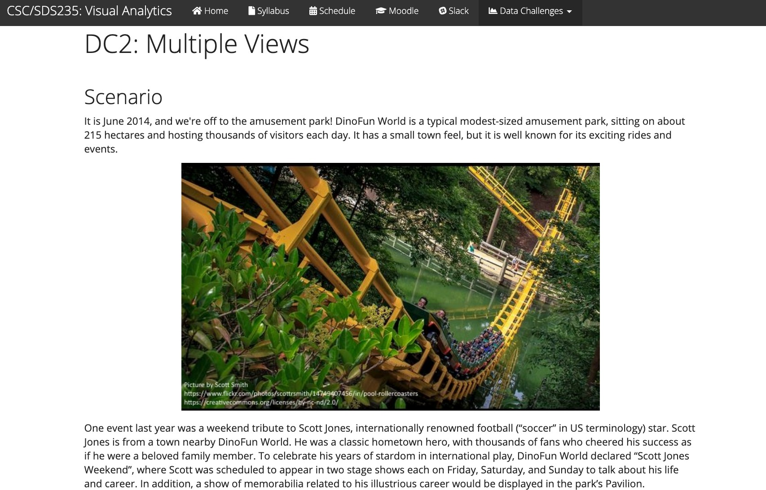
Data Challenge 2: Coordinated Views

Slide 3
Outline
Geospatial data representations
Visualization techniques
Challenges
Guidelines for making good geoviz

Slide 4

Geospatial data (def.)
Geospatial data represents features / objects in space
(usually relative to their position on the surface of the Earth)

Slide 5
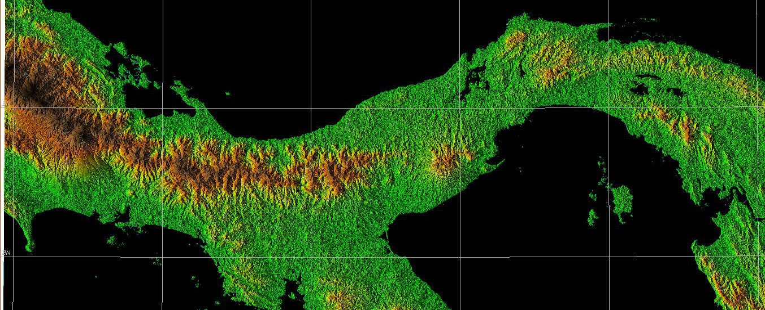
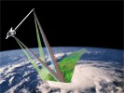
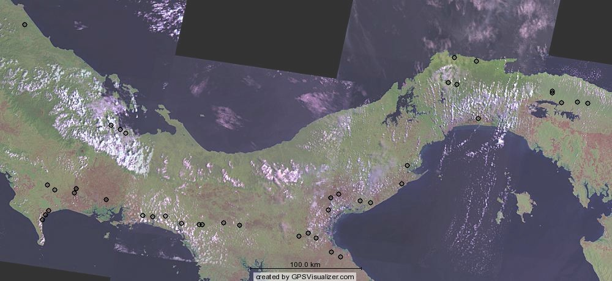
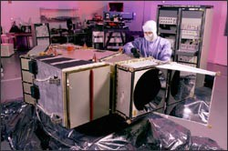
Remote sensing: satellite
Sensors:
Data:
SRTM
LANDSAT
Geospatial Analysis and Modeling MEA592 – Helena Mitasova

Slide 6
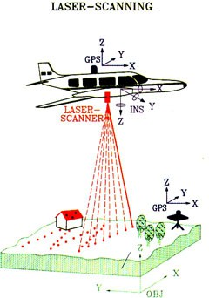
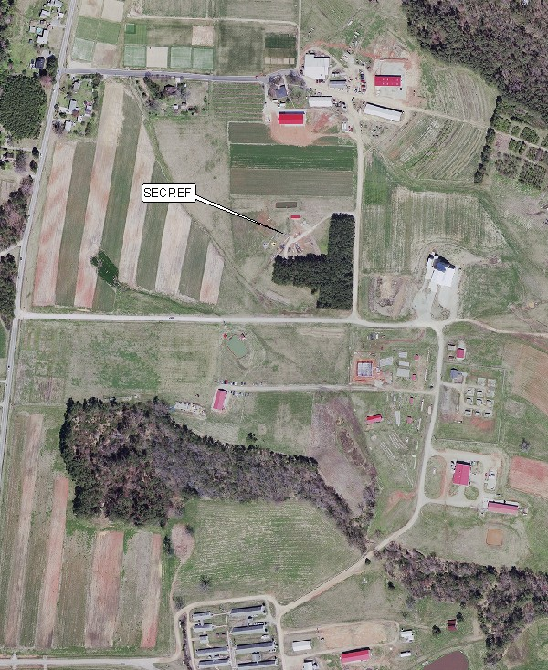
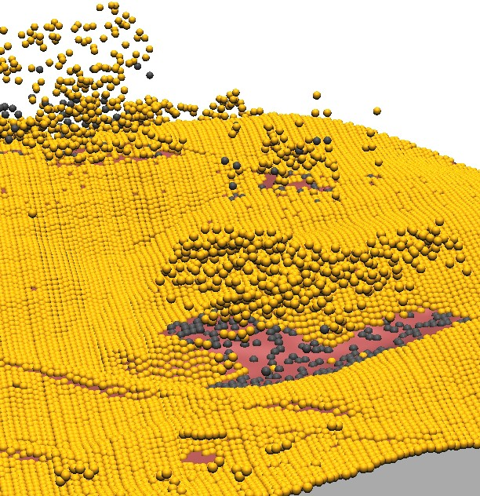
Remote sensing: airborne
Sensors:
Data: x,y,z points 1 point per 0.3m
Orthophotography 0.15m resolution
Geospatial Analysis and Modeling MEA592 – Helena Mitasova

Slide 7
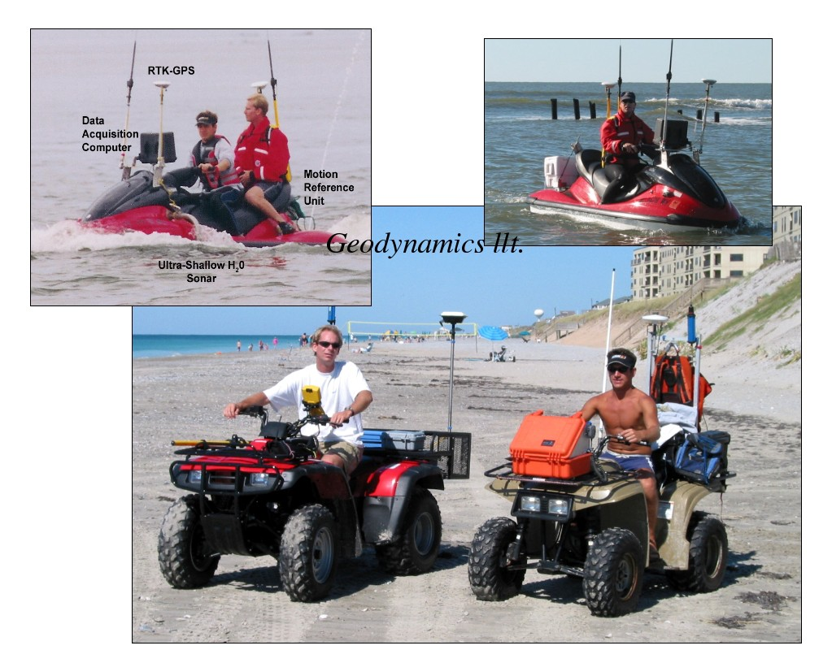
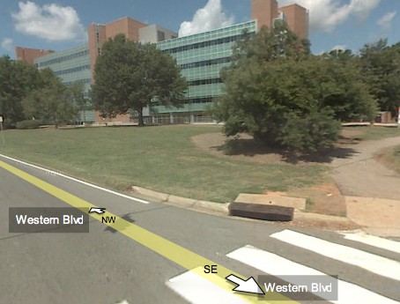
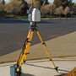
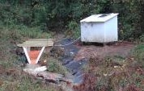
Ground-based sampling
Ground based imagery
Google Street view
Equipment: RTK GPS, Sonar, laser scanner, ISCO sampler
Geospatial Analysis and Modeling MEA592 – Helena Mitasova

Slide 8

Two kinds of geospatial information
Discrete
lines, points or areas (e.g. roads, streams, census blocks, land use)
each object has a distinct position
Geospatial Analysis and Modeling MEA592 – Helena Mitasova

Slide 9

Two kinds of geospatial information
Discrete
lines, points or areas (e.g. roads, streams, census blocks, land use)
each object has a distinct position
Continuous
a function defined over space w=f(x,y)
each point in space has a distinct value, and the change between two neighbouring values is usually small (elevation, precipitation)
Geospatial Analysis and Modeling MEA592 – Helena Mitasova

Slide 10
Geospatial data models
Two ways to project georeferenced data into discrete GIS (global information system) representations:
raster
(surface = regular grid)
vector
(feature = point, line, area w/position)
Geospatial Analysis and Modeling MEA592 – Helena Mitasova

Slide 11
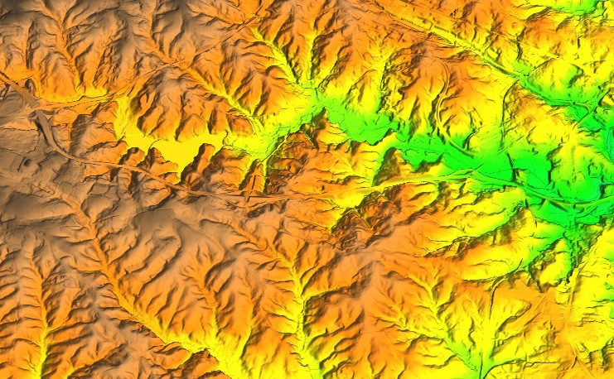
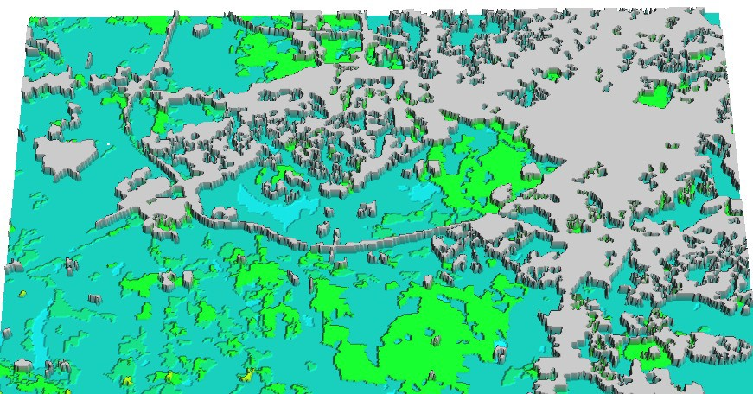
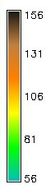
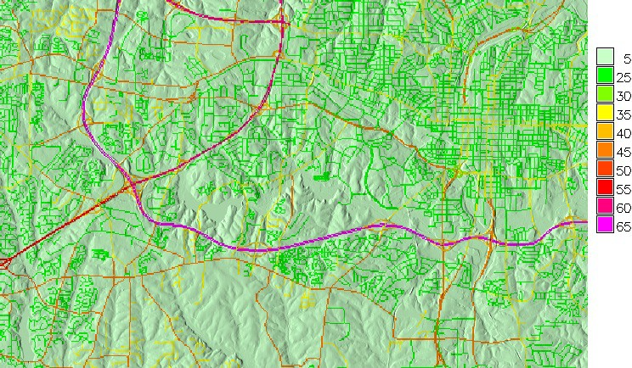
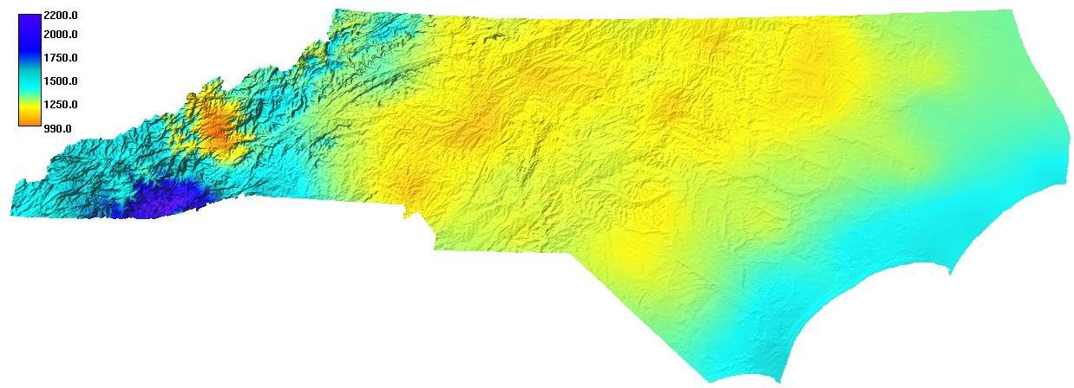
Geospatial data models: raster
continuous: elevation, precipitation discrete: land use, roads
5 developed
1 water
3 herbaceous
Geospatial Analysis and Modeling MEA592 – Helena Mitasova

Slide 12
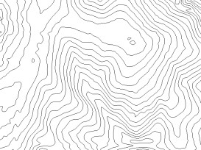
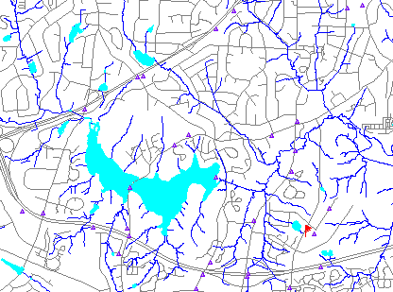
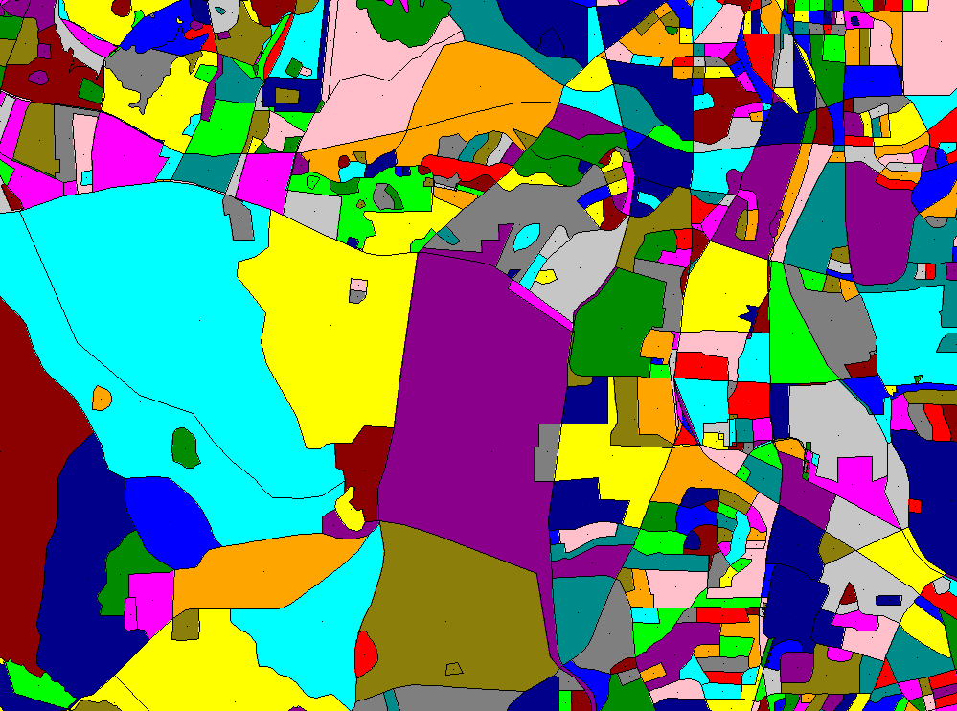
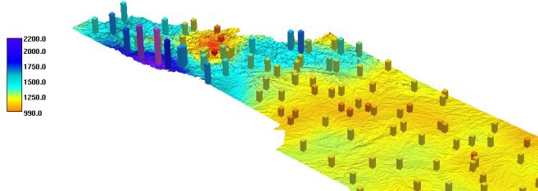
Geospatial data models: vector
continuous: isolines, distribution discrete: streets, streams, census blocks
Geospatial Analysis and Modeling MEA592 – Helena Mitasova

Slide 13

Geographic visualization
Most common: maps
Useful for making geospatial comparisons

Slide 14

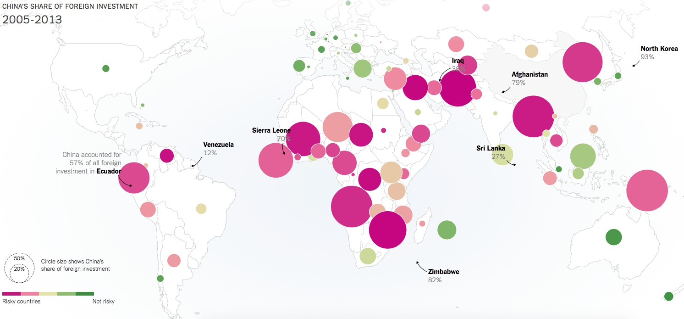
Geographic visualization: points

Slide 15
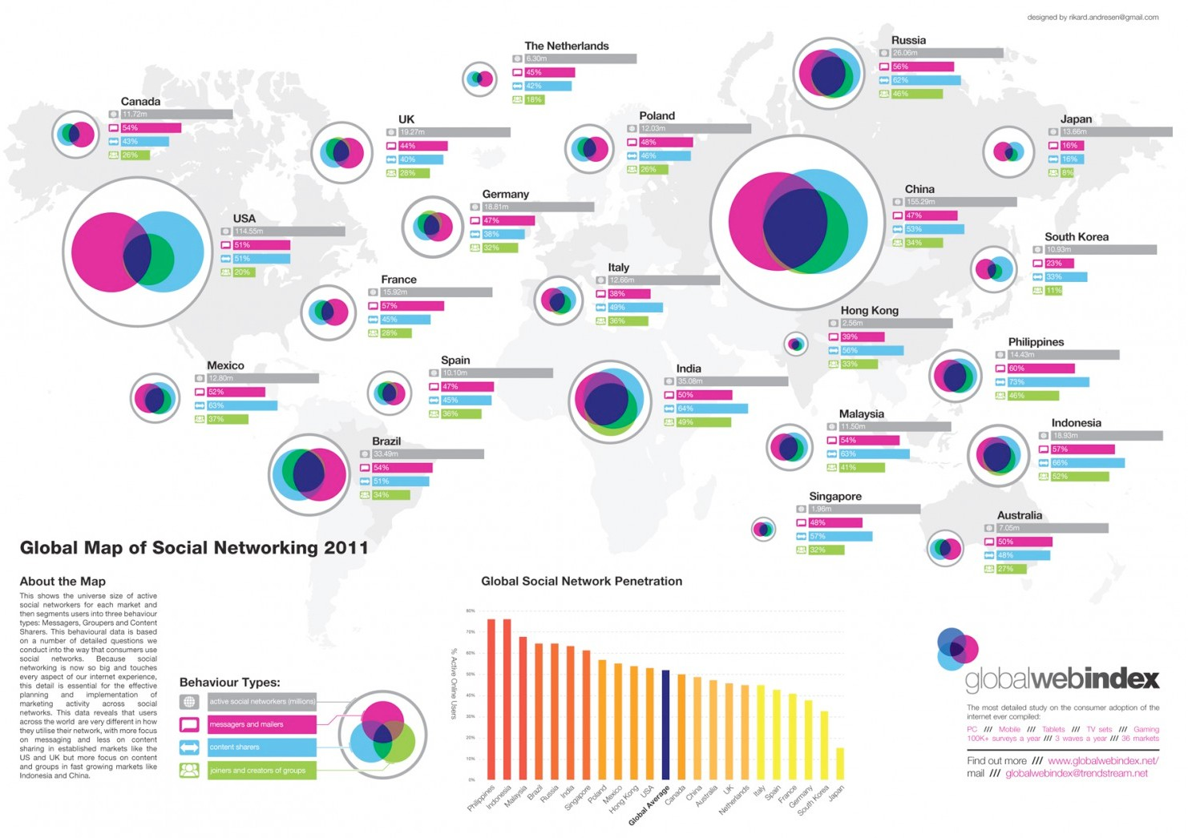
Geographic visualization: glyphs

Slide 16
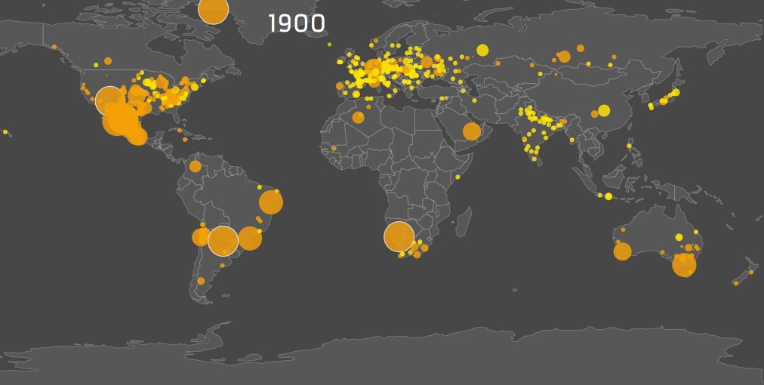
Geographic visualization: over time

Slide 17
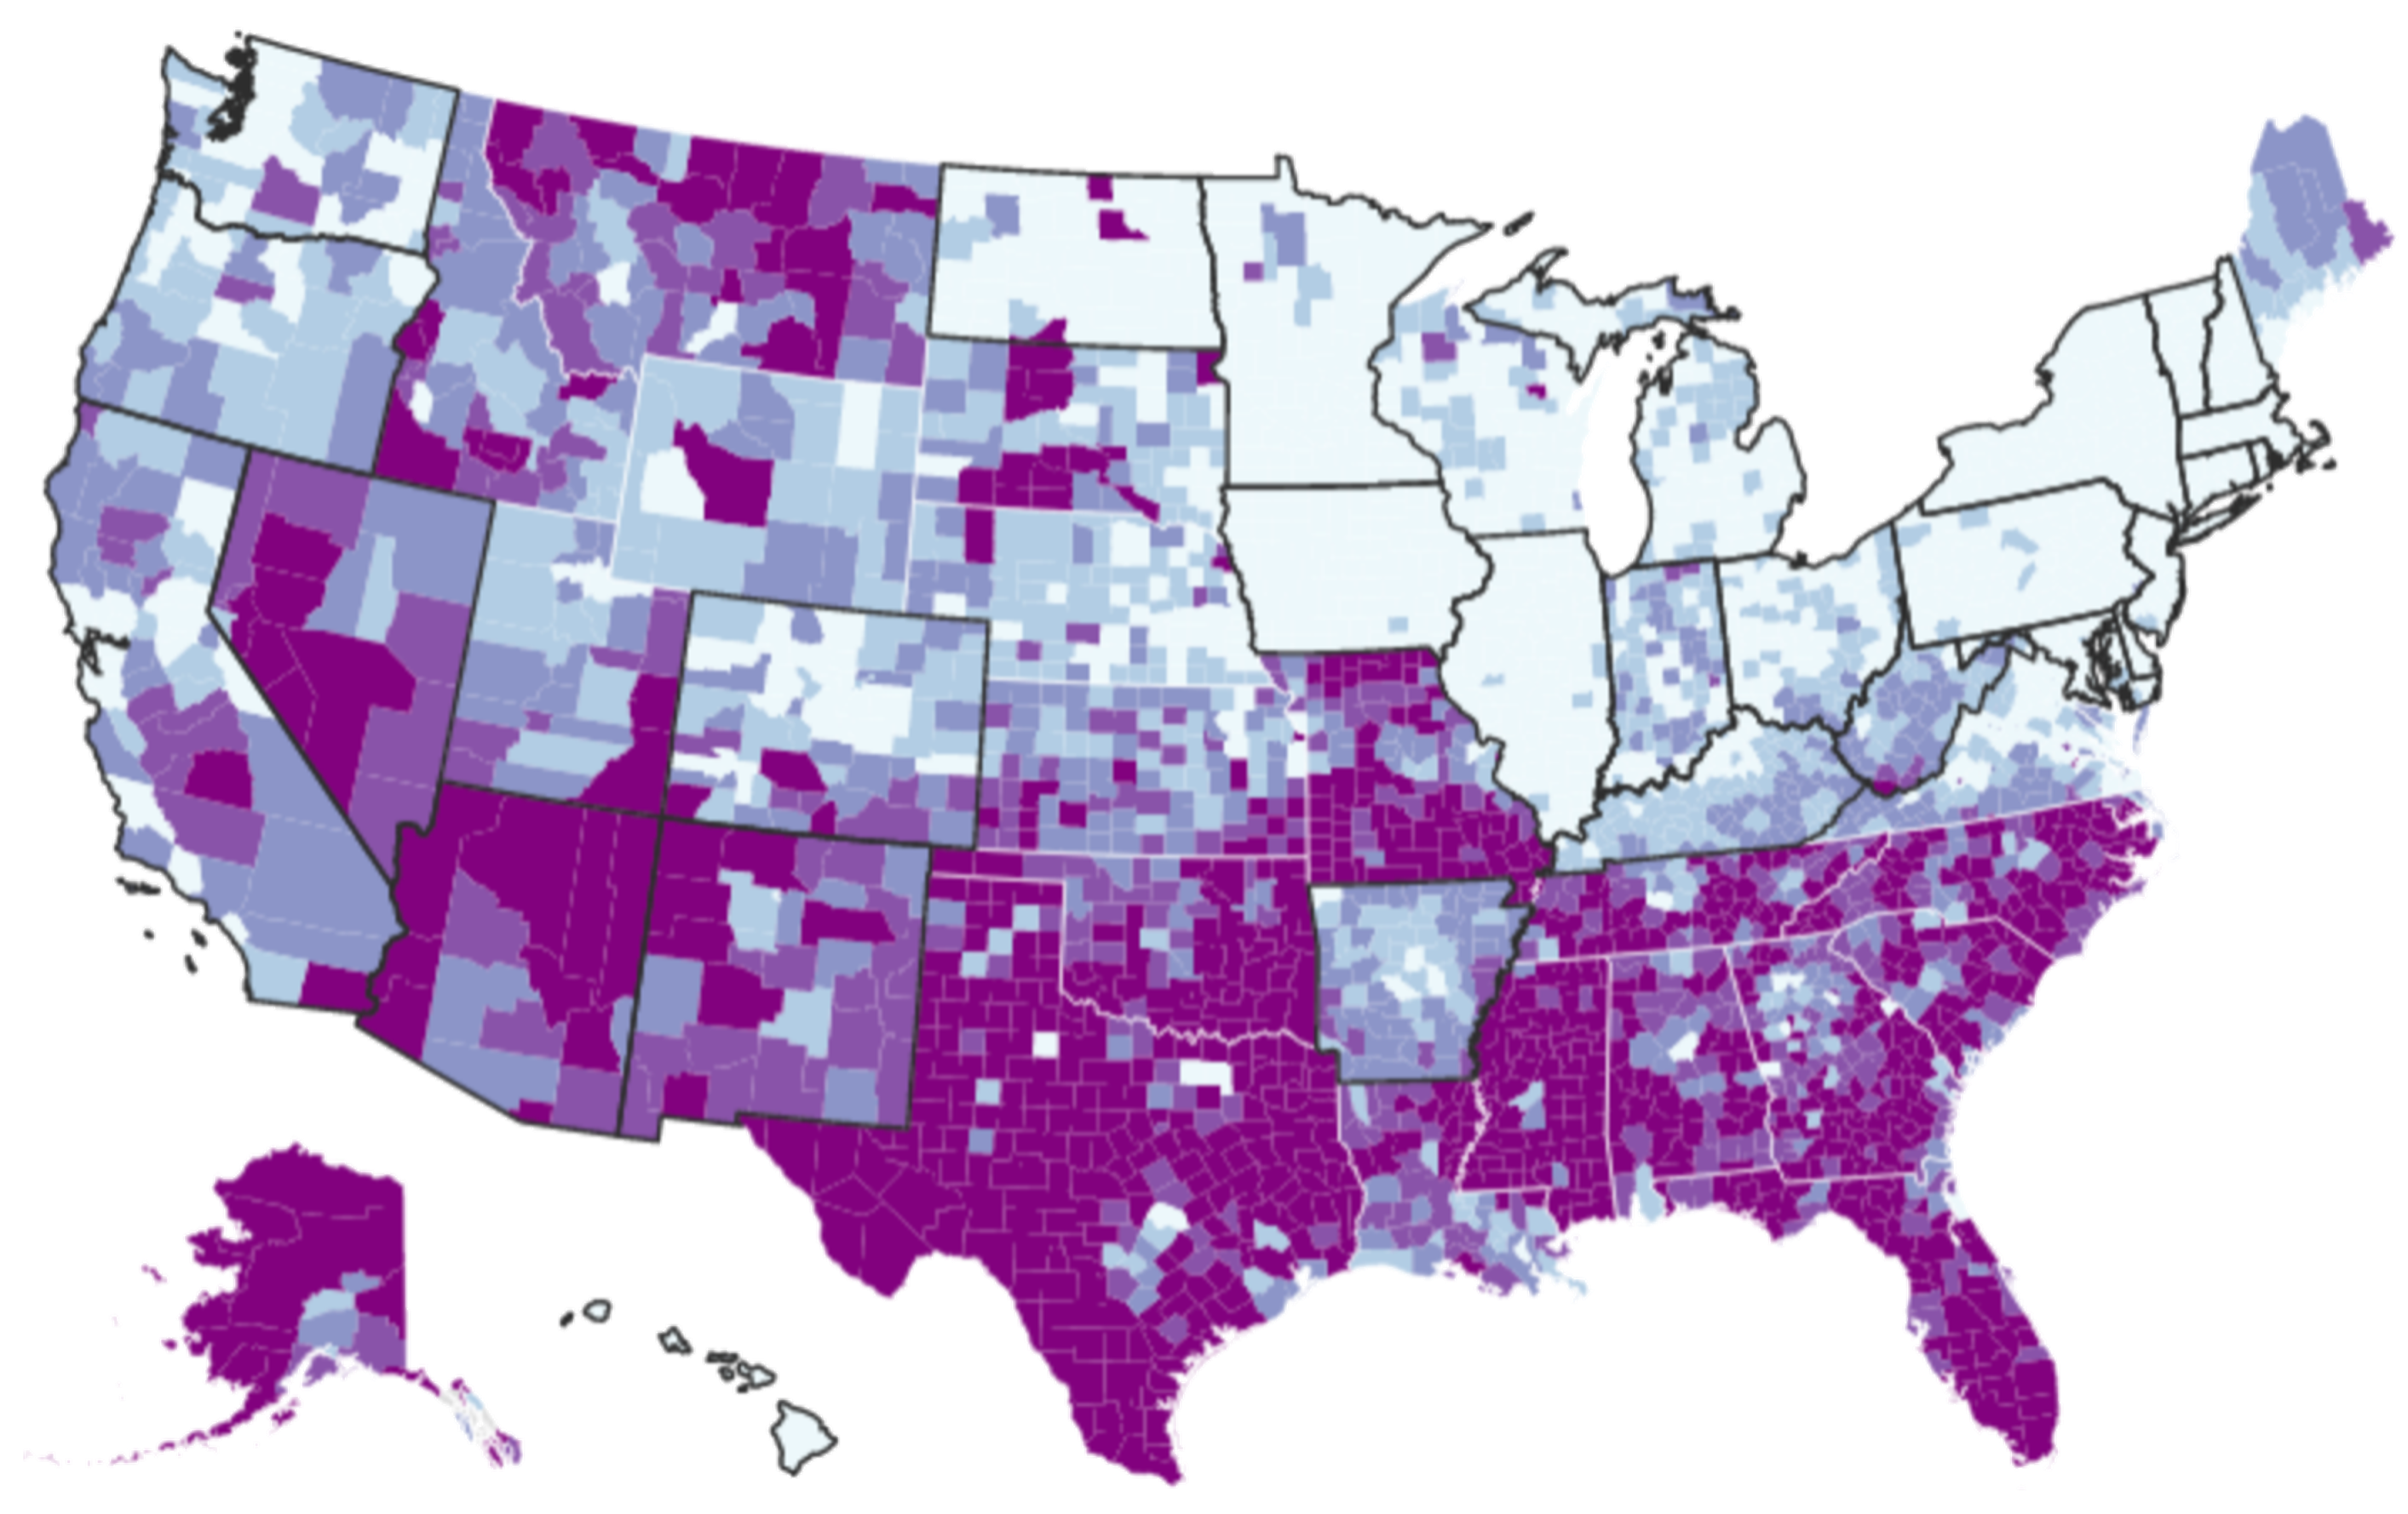


Geographic visualization: filled regions

Slide 18
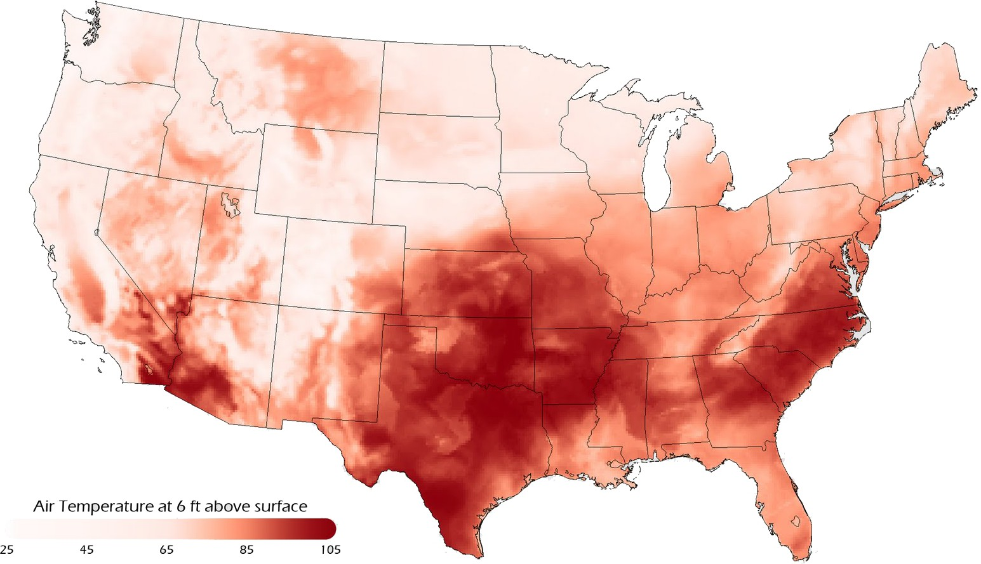
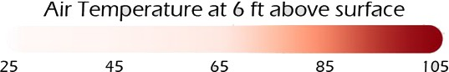
Geographic visualization: heatmaps

Slide 19
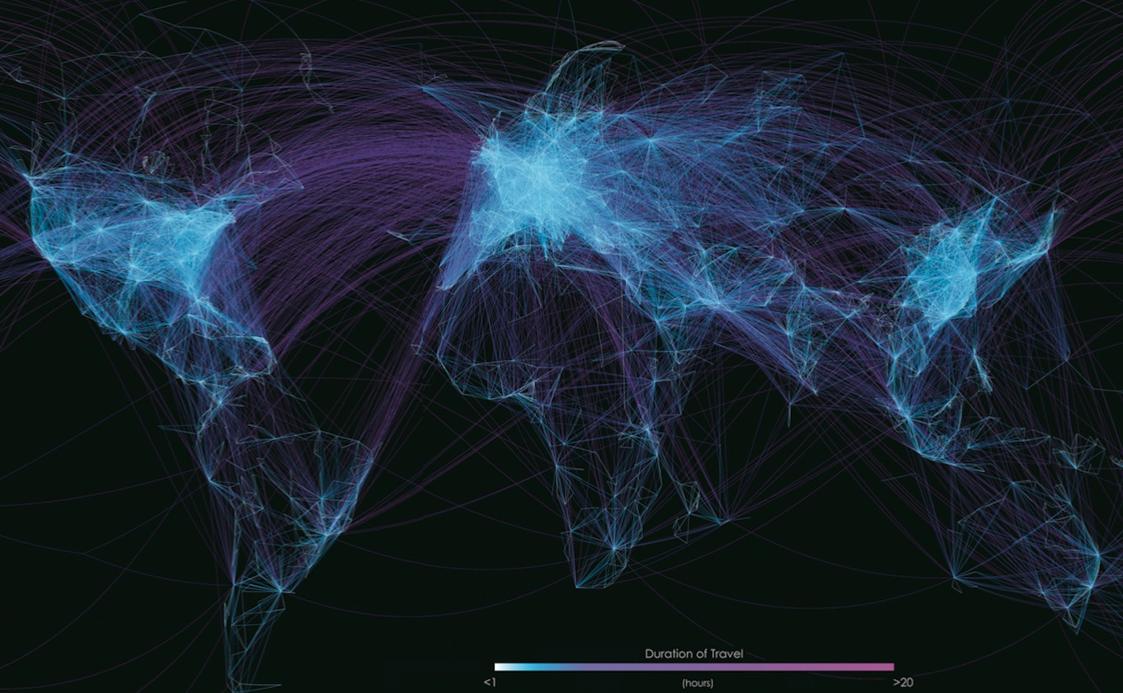
Geographic visualization: connections

Slide 20
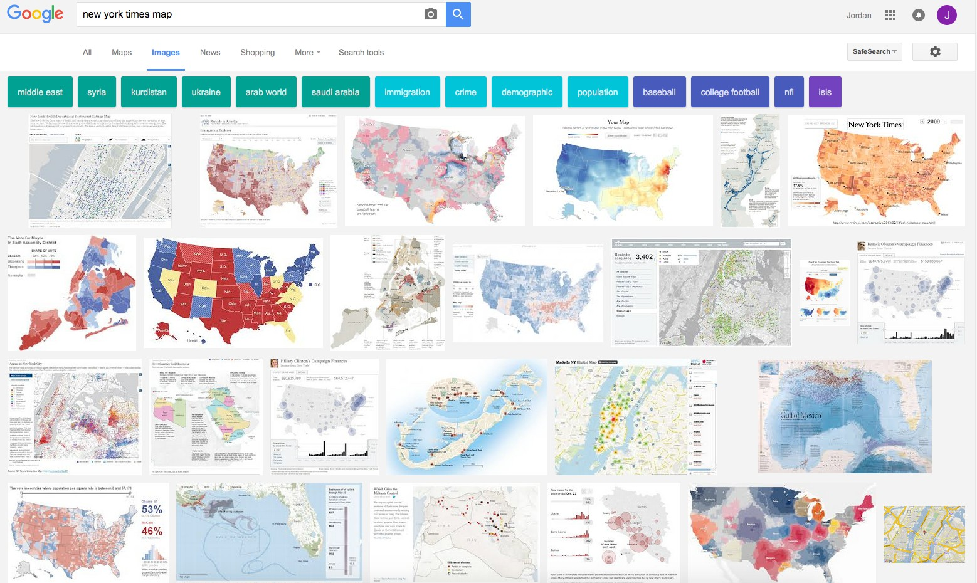
Examples: NYT maps

Slide 21

Discussion
Question:
What makes geographic visualizations so compelling?

Slide 22


Challenge 1: flat earth?

Slide 23
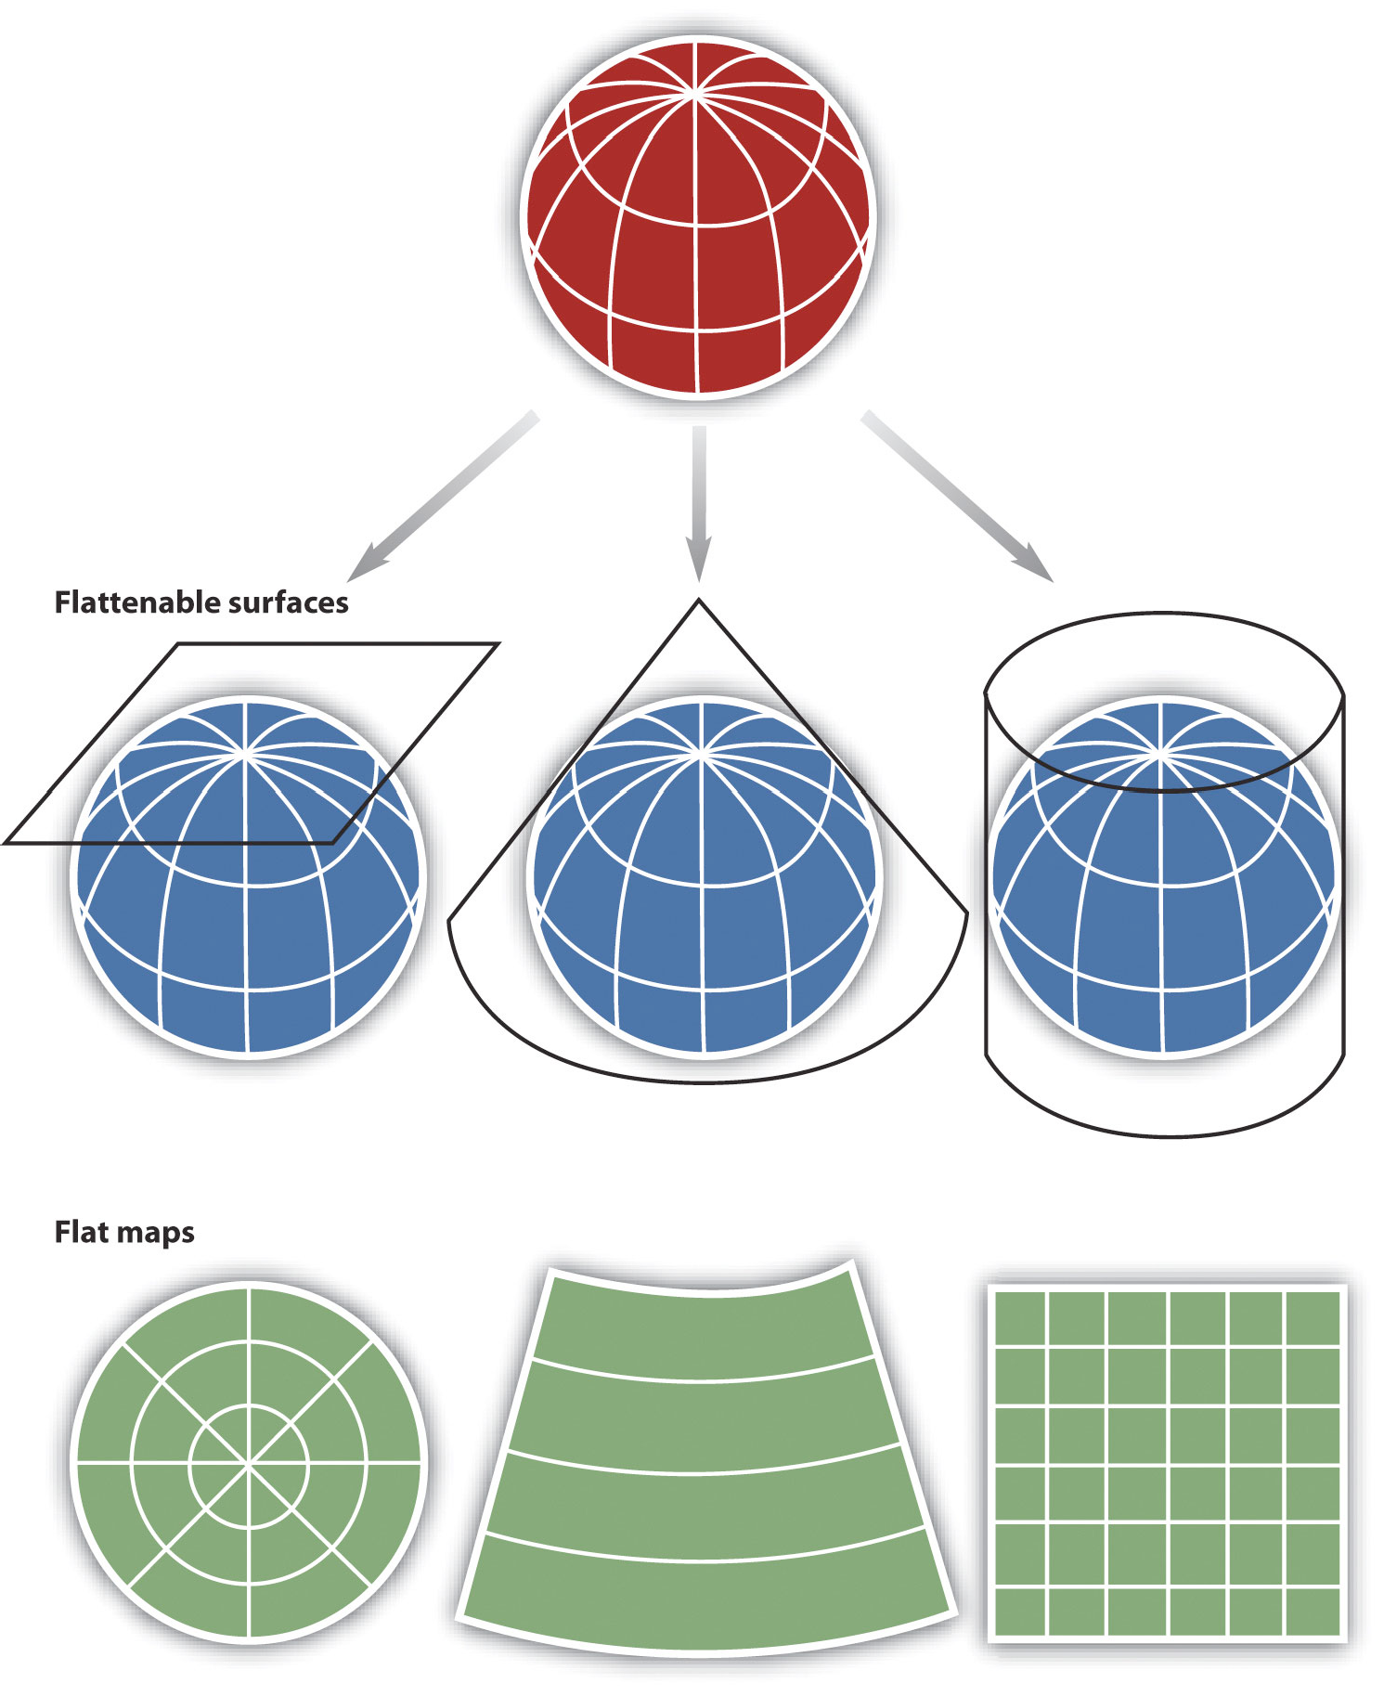
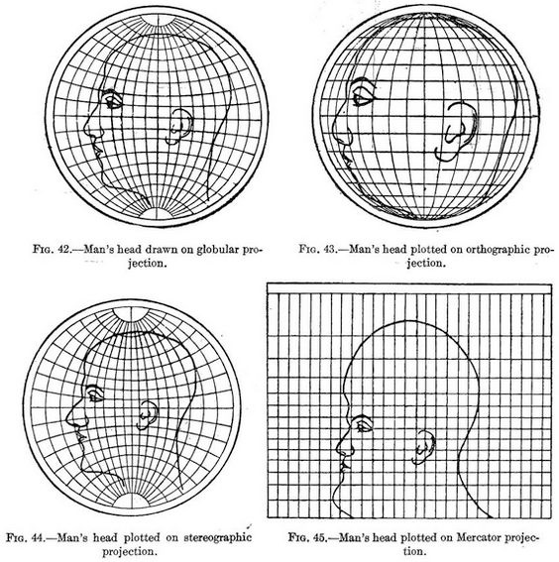
Impact of map projections
Campbell, J.E., & Shin, M. (2012). Geographic Information System Basics.
Deetz, C. H., & Adams, O. S. (1921). Elements of map projection with applications to map and chart construction.

Slide 24
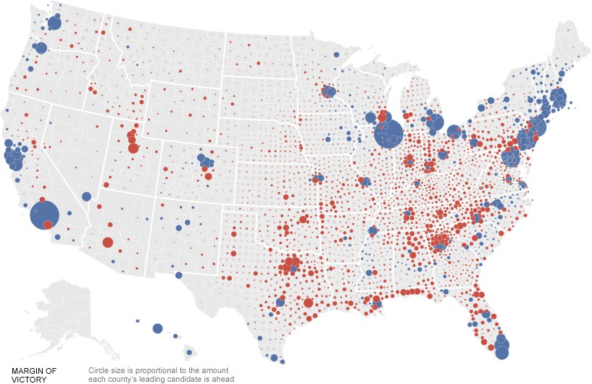
Challenge 2: granularity mismatch
Image courtesy of politicalmaps.org

Slide 25
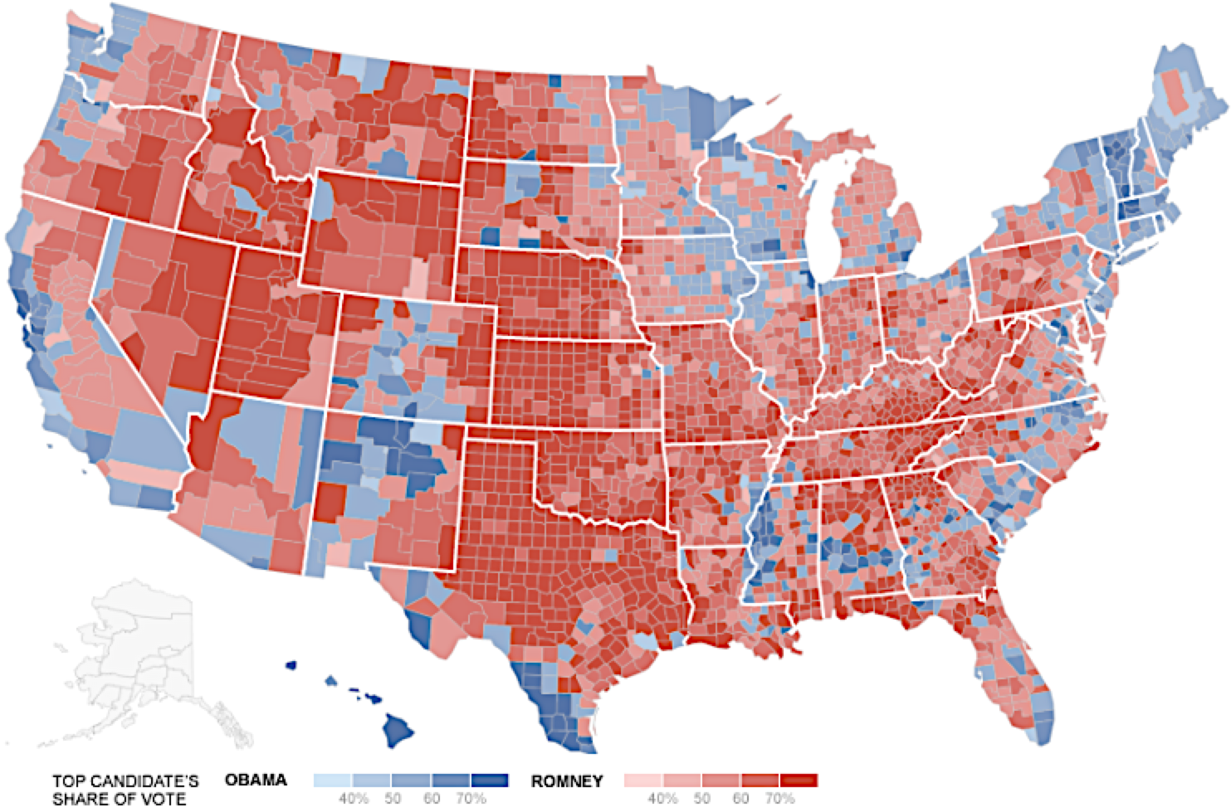
Example: 2012 US Presidential Election
Image courtesy of politicalmaps.org

Slide 26
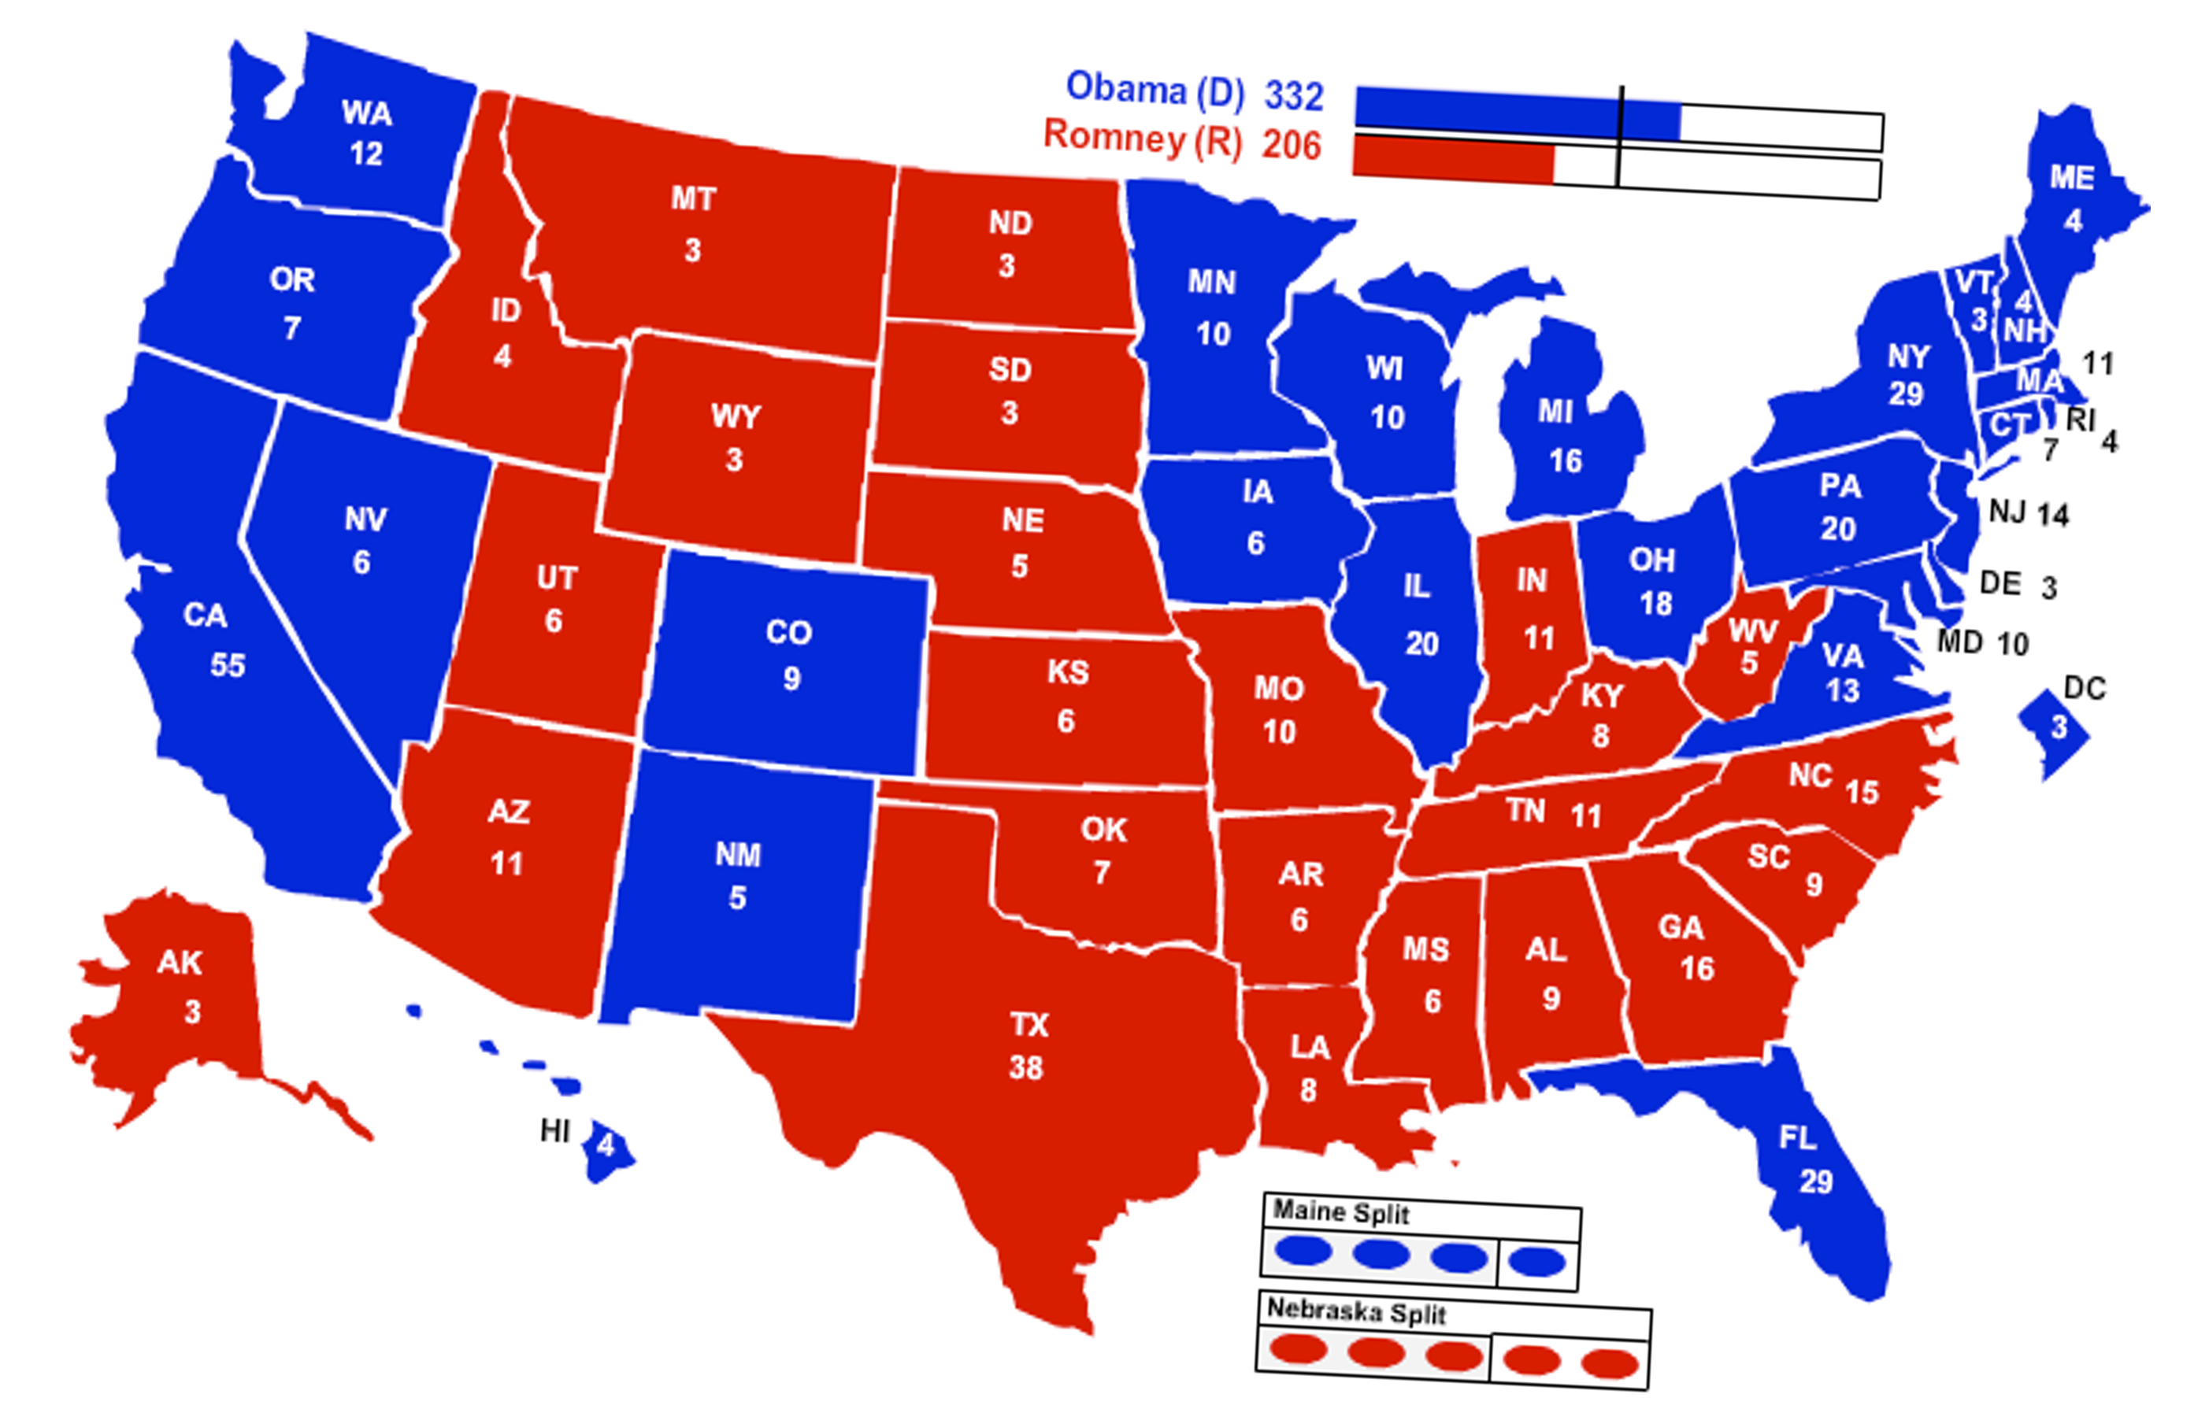
Example: 2012 US Presidential Election
Image courtesy of politicalmaps.org

Slide 27



Challenge 3: perceptual trickery
Flashback to when we talked about perception
What preattentive features are at work in these maps?
clustering (proximity)
color (hue)
size

Slide 28
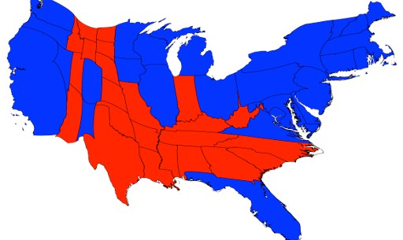
Example: 2012 US Presidential Election
Image courtesy of http://politicalmaps.org

Slide 29


Example: 2012 US Presidential Election
OBAMA
332
270 votes
needed to win
ROMNEY
206
Number of Electoral Votes Captured

Slide 30
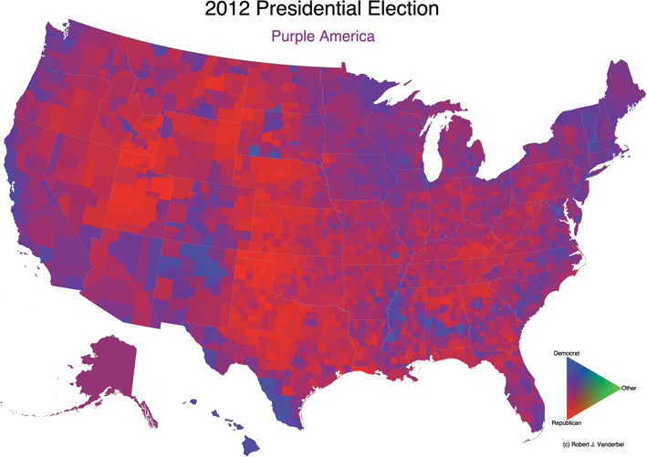



Challenge 4: non-adjacent comparison
Are Maine and
S. California voting similarly?
Image courtesy of http://politicalmaps.org

Slide 31
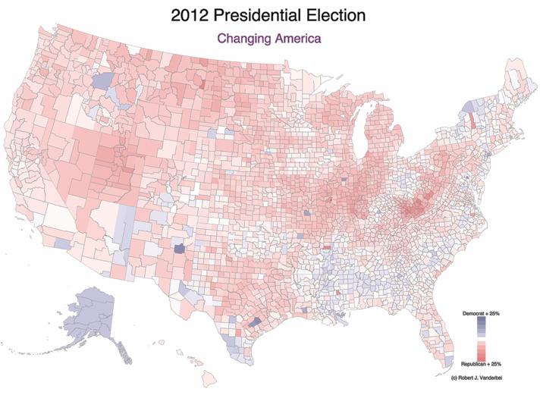
Challenge 5: missing data
Image courtesy of http://politicalmaps.org

Slide 32

Challenge 6: occlusion
What’s going on in Turkmenistan and Uzbekistan?

Slide 33
Discussion: (rough) guidelines for maps
Question:
What do we need to keep in mind
to make good geographic visualizations?

Slide 34

Demo
making interactive maps with

Slide 35
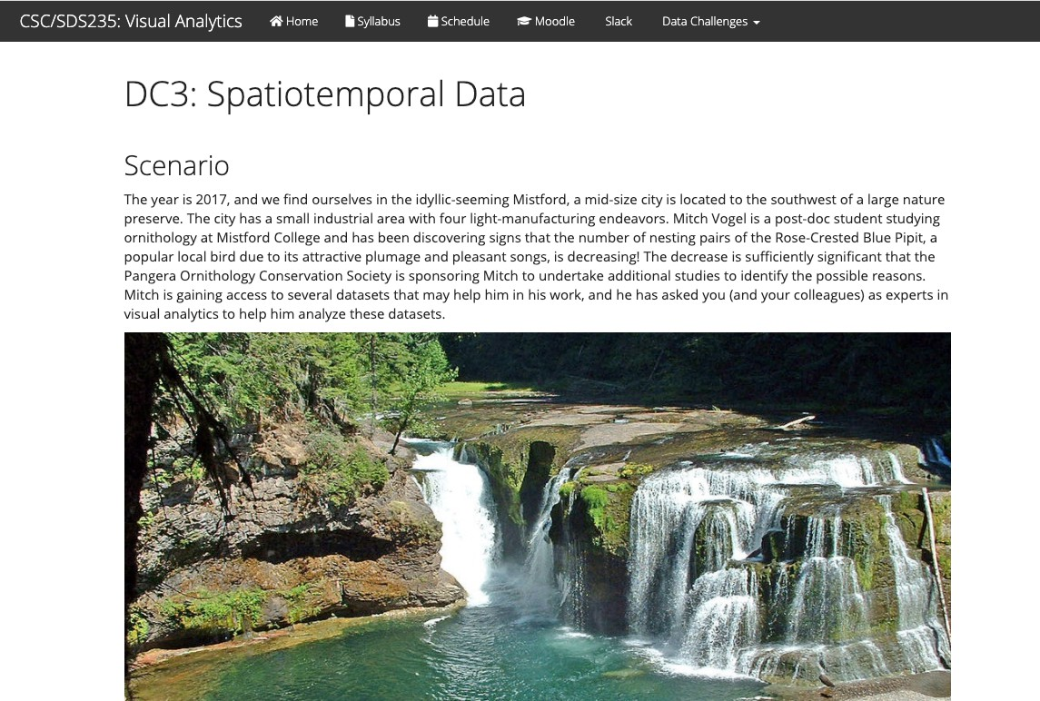
Data Challenge 3: Spatiotemporal Data

Slide 36

Up next
Thursday: network / graph data
Guest speaker!

